Slide 1

ONLINE QUIZ SYSTEM

Slide 2

OUR TEAM
V Nikhil Chandra – 2310030366
N Charan Reddy – 2310030322
G Sai Krishna - 2310030291
K Sai Dheeraj - 2310030353

Slide 3

Online Quiz System
Our project is an Online Quiz System Website designed to streamline the quiz process for both students and teachers. It features separate logins for students and teachers, ensuring a personalized experience for each user type.
Users can easily create quizzes, monitor student performance, and view detailed analytics. On the other hand, students can attempt quizzes and view their results instantly. The website is built with a modern design and a user-friendly interface.

Slide 4
Features
Interactive and User-Friendly Interface
Robust Question Management using Maps
Efficient Scoring and Leaderboard Tracking
Real-Time Performance Analytics
The system features a simple and intuitive interface, making it accessible to users with varying levels of technical expertise.
Advanced data structures, including maps, are employed to effectively manage questions, ensuring efficient organization and retrieval.
The system automatically calculates scores and tracks user progress, allowing for competitive leaderboard functionality.
Comprehensive real-time analytics provide insights into user performance, enabling informed decision-making and improvement strategies.

Slide 5
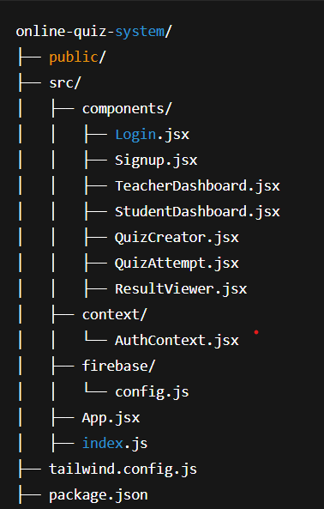
Code Structure
Our project is organized for clarity and scalability. The src folder contains all core files:
components/ – Includes all React components like login forms, dashboards, quiz creator, and quiz attempt pages.
context/ – Manages global authentication state using React Context.
firebase/ – Stores Firebase configuration for authentication and Firestore.
App.jsx – Main component handling routing between pages.
index.js – Entry point of the React app.
This structure keeps the code modular, readable, and easy to maintain.

Slide 6
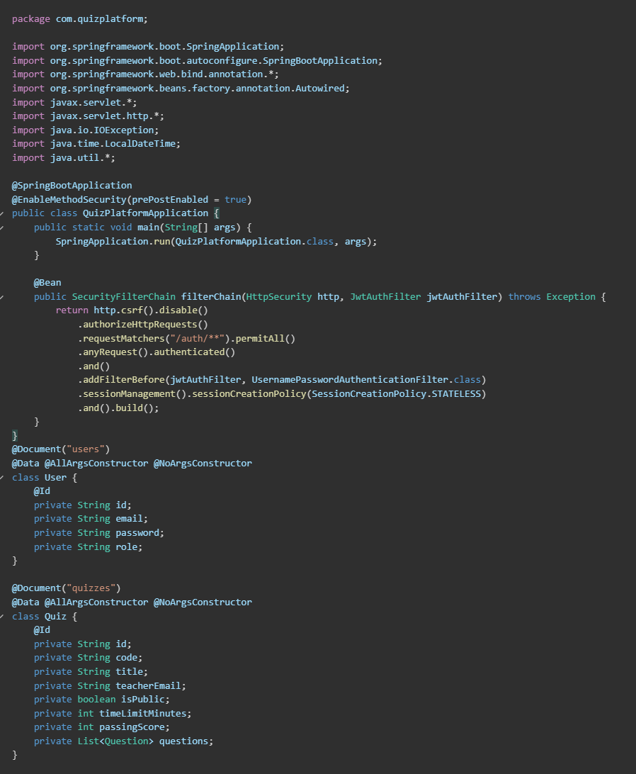
Sample Code
It connects frontend to Firebase backend
Shows authentication flow
Demonstrates role-based dashboard redirection
Highlights use of React Hooks, Firebase, and modern
Styling with Tailwind CSS

Slide 7
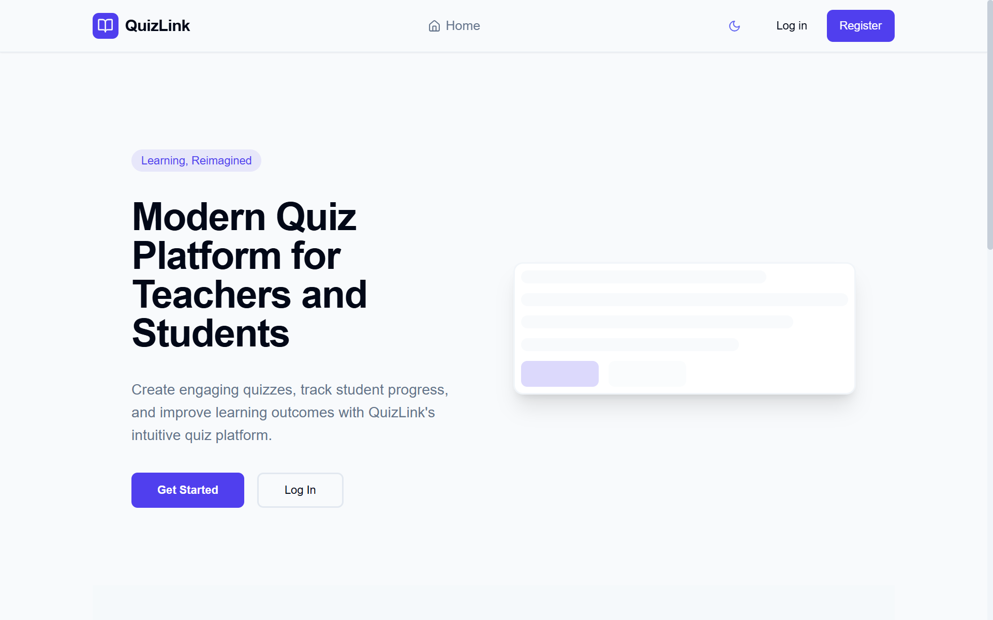
Home Page

Slide 8
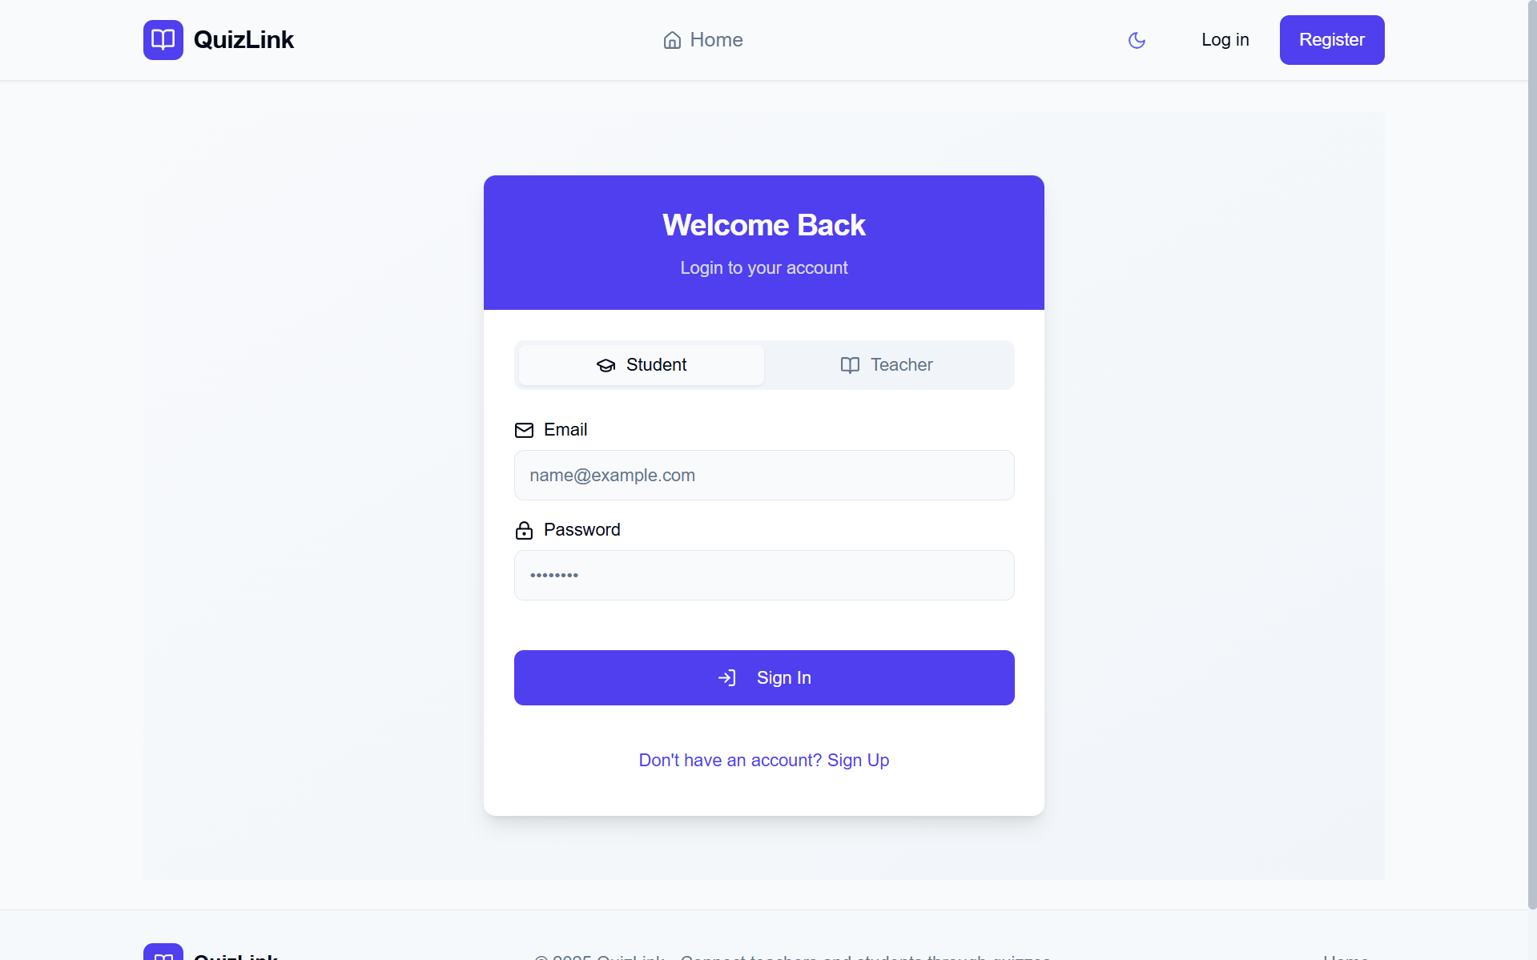
Login and Signup

Slide 9
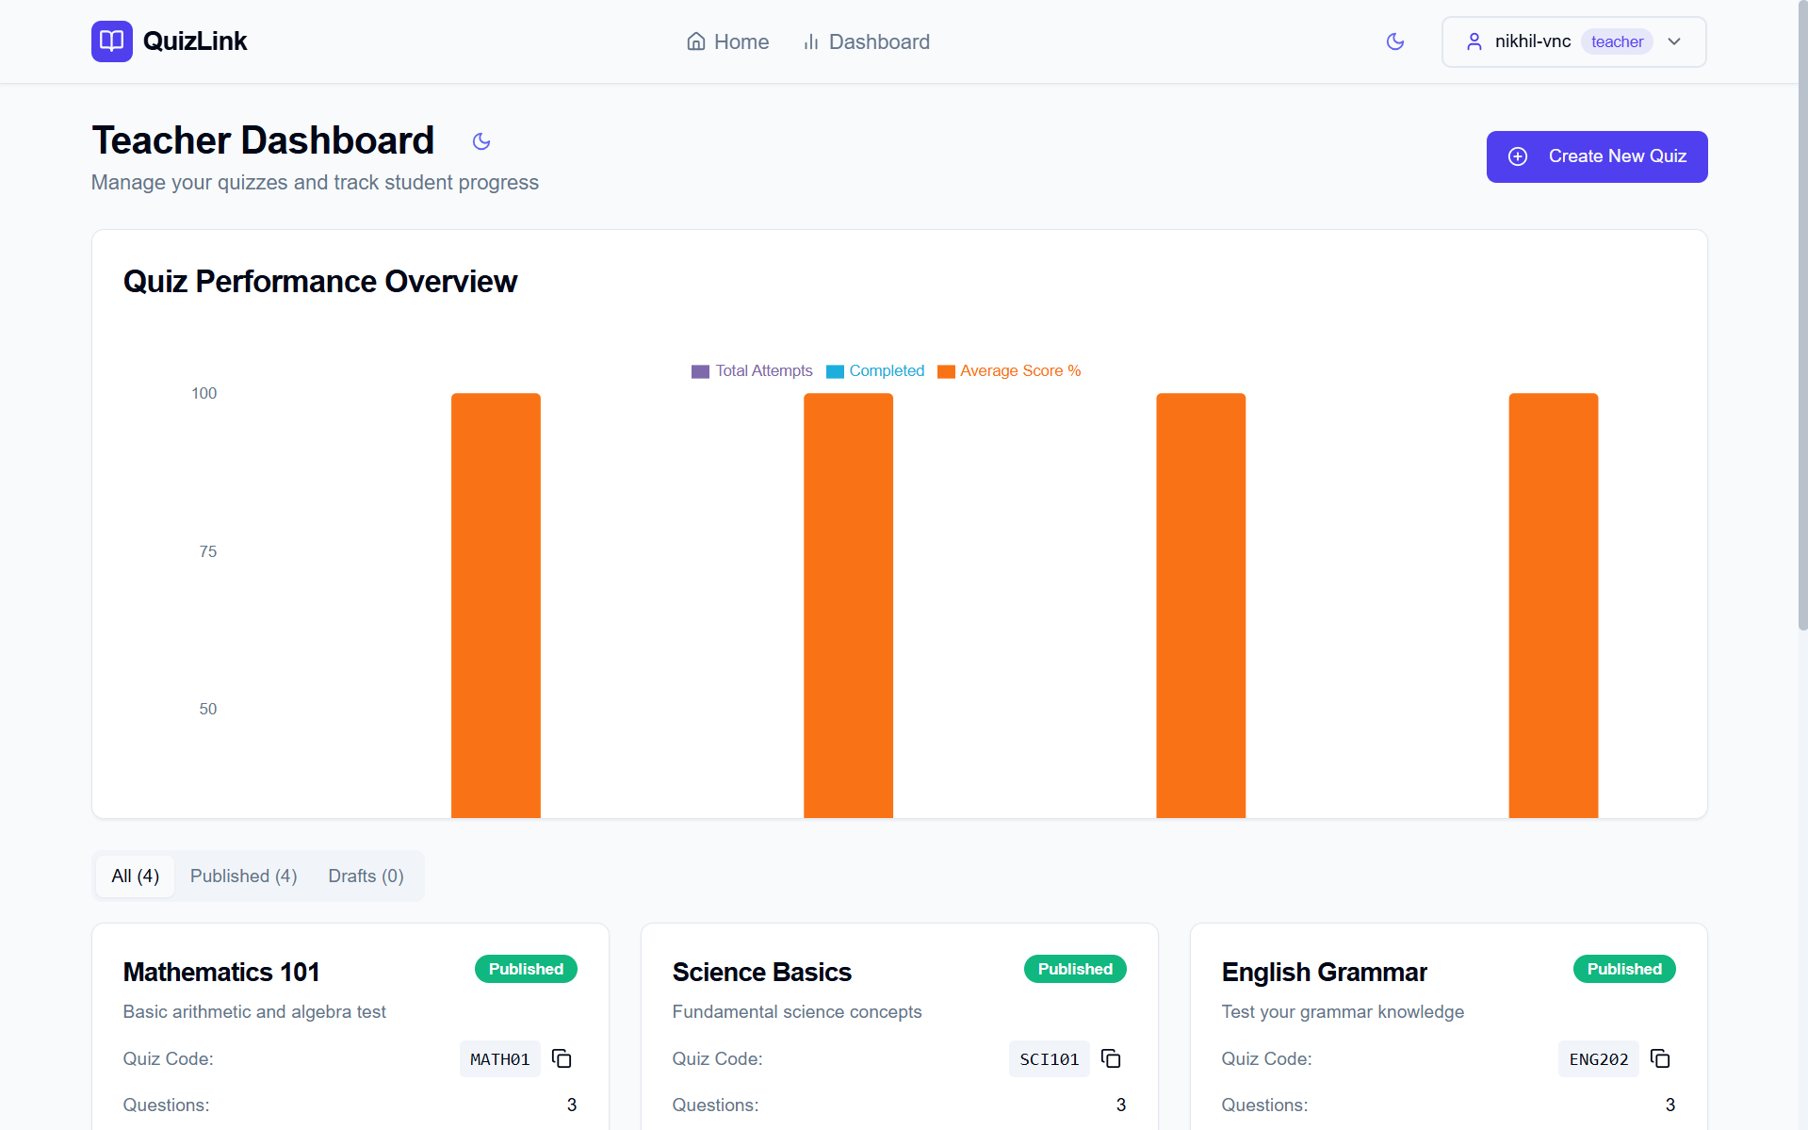
Teacher Dash Board

Slide 10
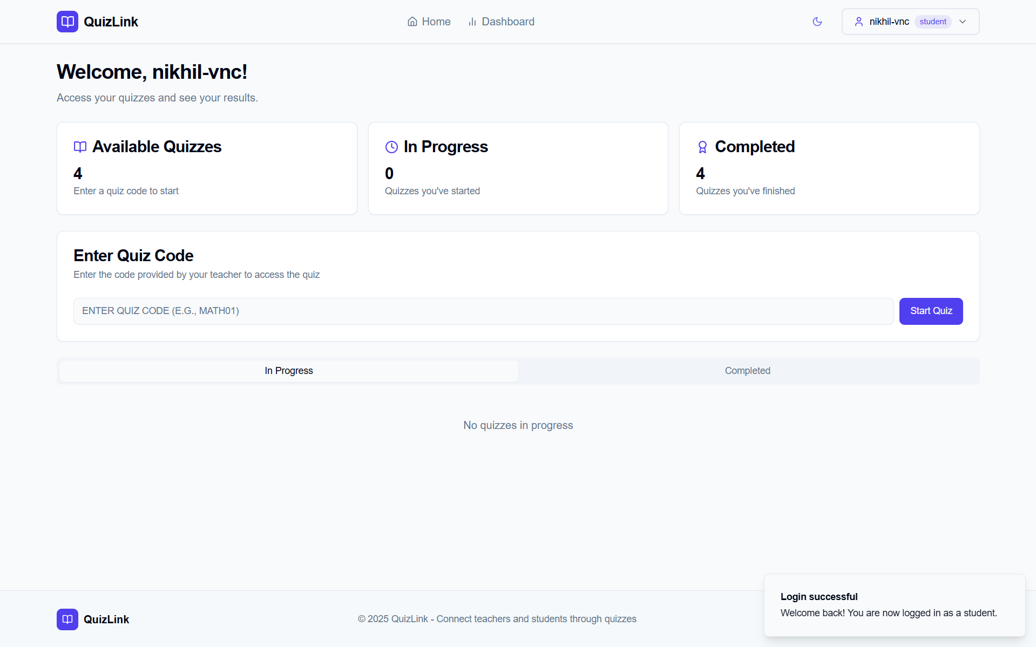
Student Dash Board

Slide 11
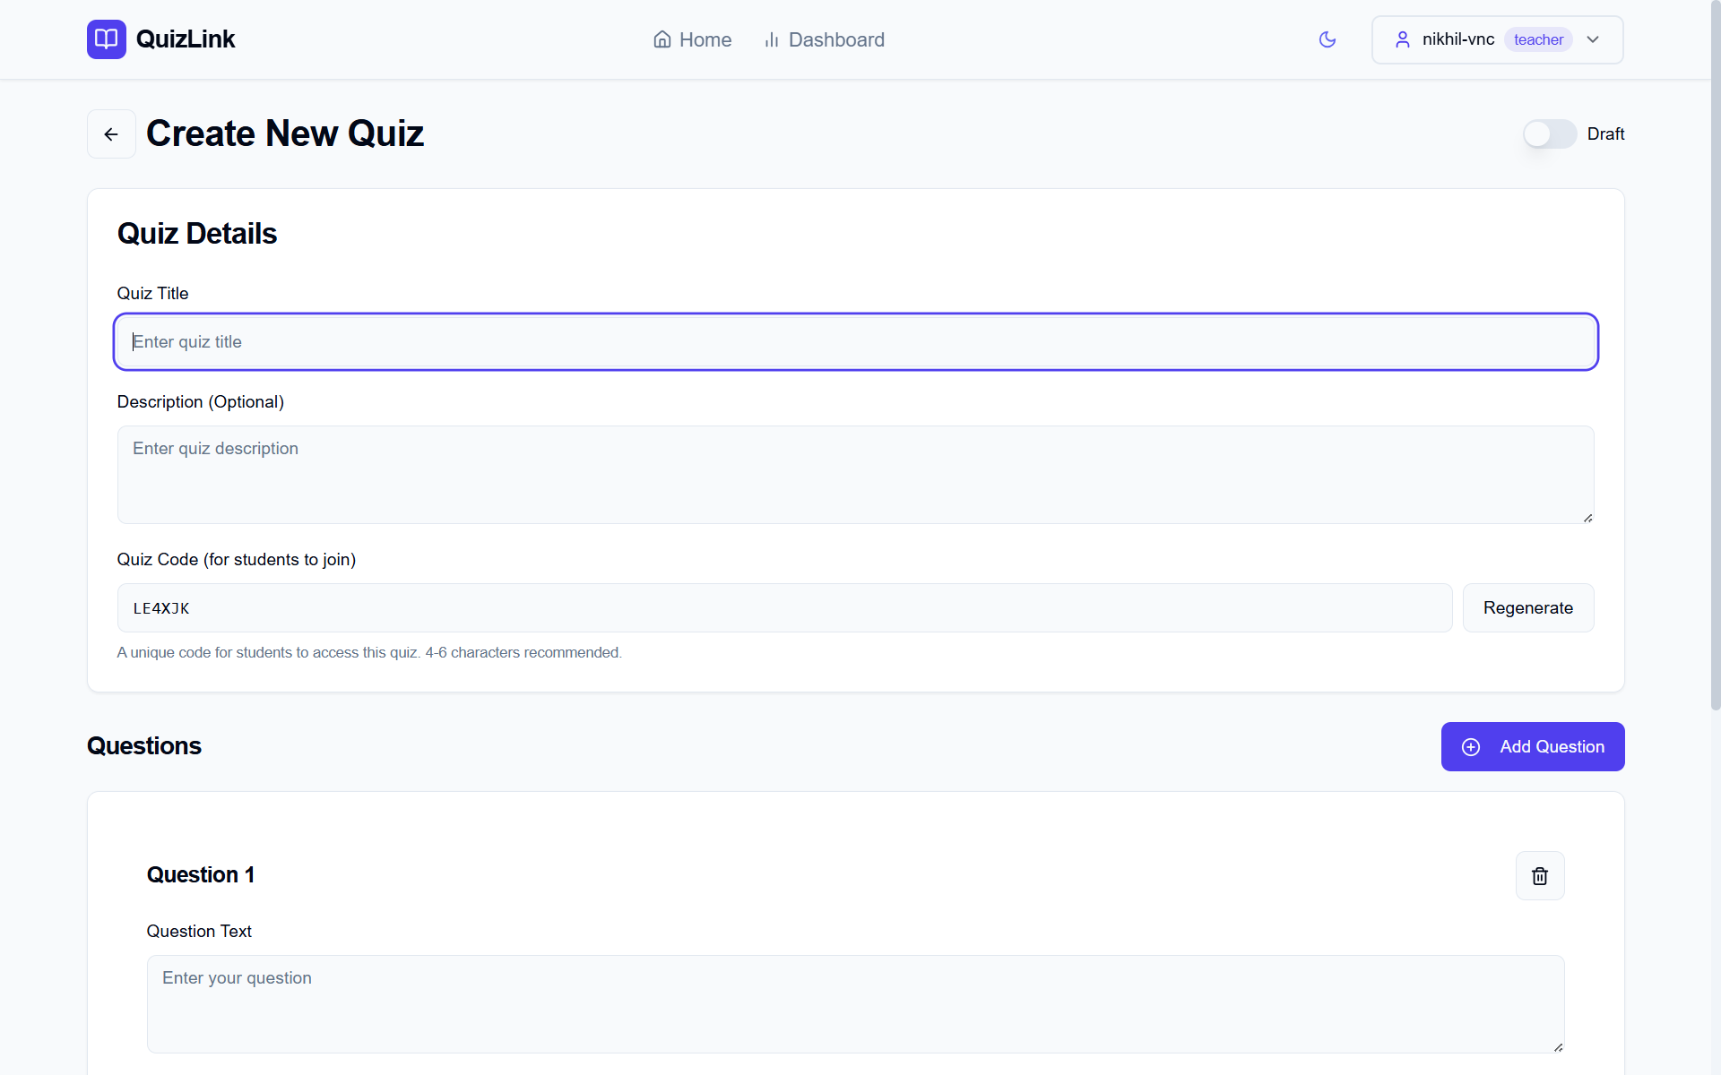
Creating Quiz

Slide 12
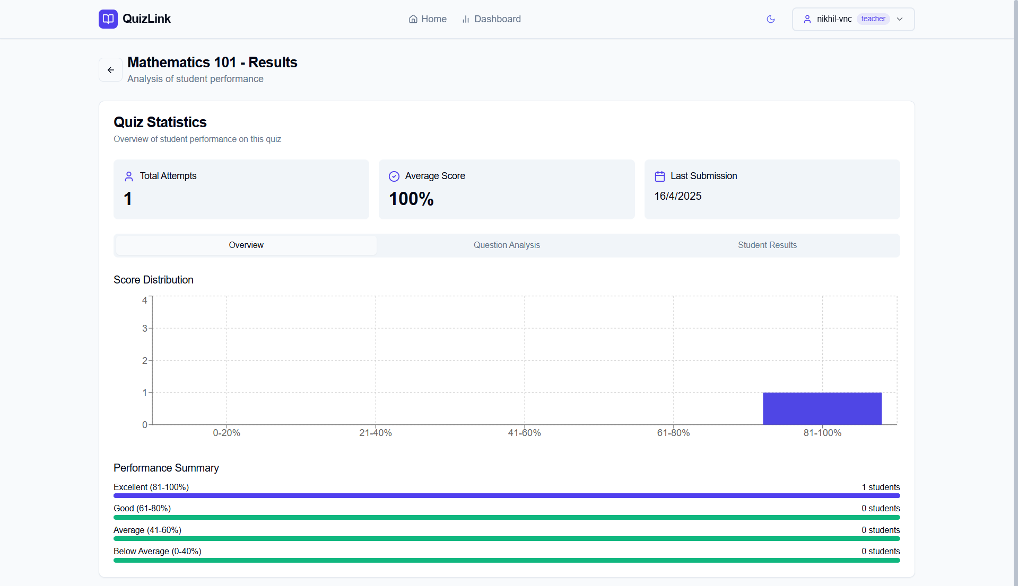
Quiz Analysis

Slide 13
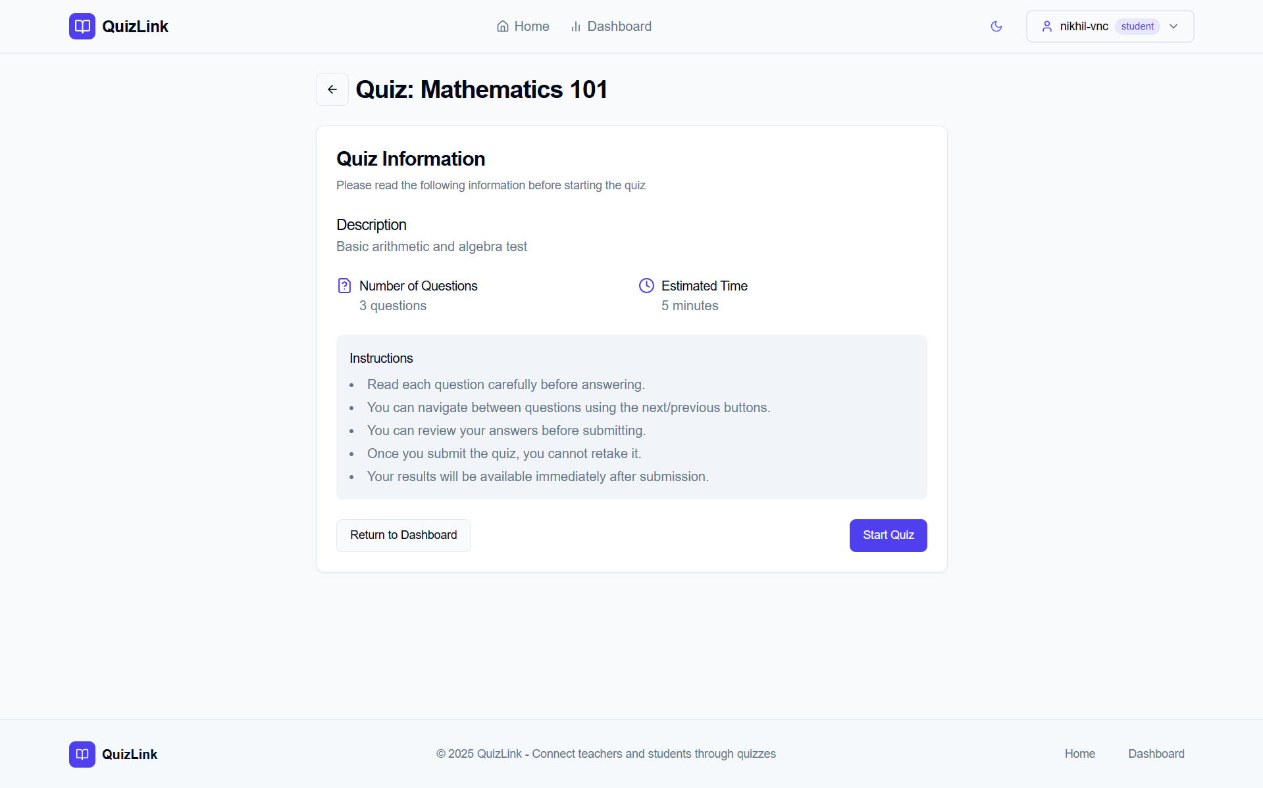
Attempting Quiz

Slide 14
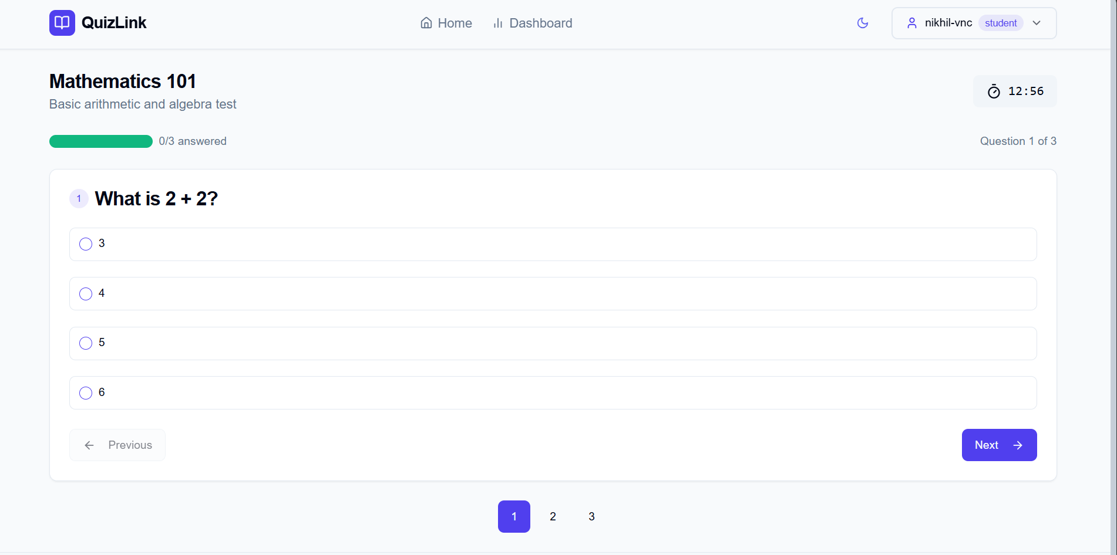
Attempting Quiz

Slide 15
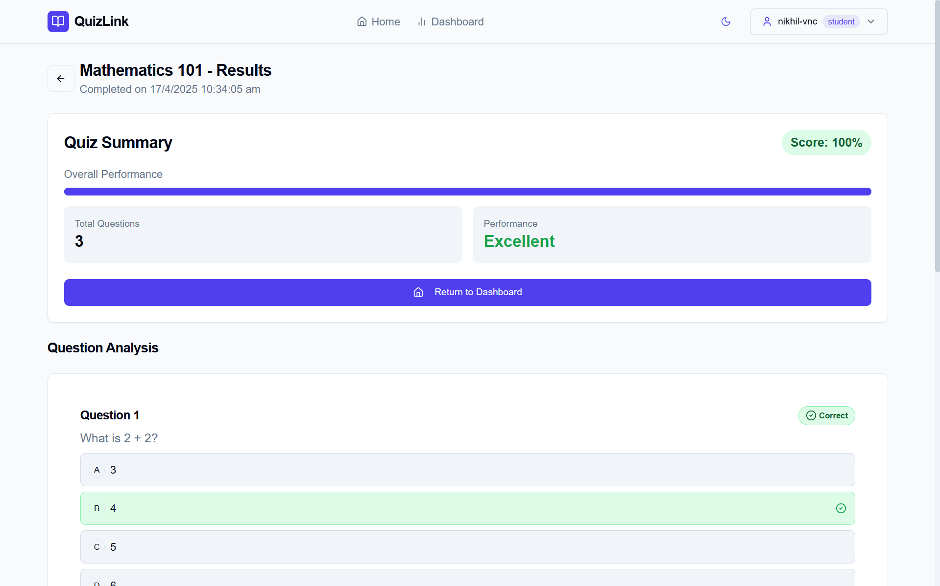
Quiz Results

Slide 16
Thank You

